Slide 1
Fit – Part 3

Slide 2
Action Fixtures
A series of actions carried out with expected outcomes
Used for multi-step processes aka workflows

Slide 3
ActionFixtures Involve
starts a named class
The named class is the actor – also known as the fixture class
The starts tells the actor to start the SUT
check calls the named method of the actor
the return of the method should match the expected value in the table
enter calls the named method of the actor
the named method takes the specified parameter
The parameter is used in the next action
press calls the named method of the actor
the named method should invoke a method on the SUT passing the value from the previous enter row

Slide 4
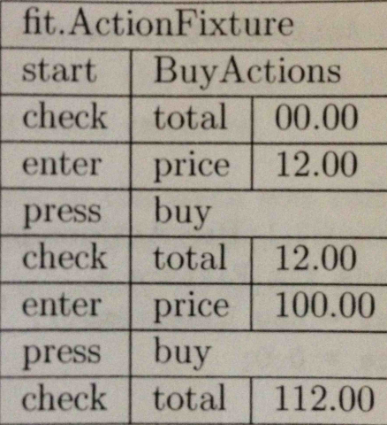
Interpreting an Action Fixture Table
Fixture Type
Fixture Class Name
Initial Action
Action sequence

Slide 5
Goal for a ActionFixture Class
The goal is to
Name the fixture class as the actor
Instantiate the SUT
Map
the check method from the table
the enter method from the table
the press method from the table

Slide 6
The ActionFixture Class
public class BuyActions extends fit.ActionFixture {
private LineItems sut = new LineItems();
private double currentPrice = 0.0;
public void price(double currentPrice) {
this.currentPrice = currentPrice;
}
public void buy() {
sut.buyFor(currentPrice);
}
public double total() {
return sut.totalIs();
}
}

Slide 7
Inheritance
public class BuyActions extends fit.ActionFixture {
private LineItems sut = new LineItems();
private double currentPrice = 0.0;
public void price(double currentPrice) {
this.currentPrice = currentPrice;
}
public void buy() {
sut.buyFor(currentPrice);
}
public double total() {
return sut.totalIs();
}
}

Slide 8
Start - Fixture Name
public class BuyActions extends fit.ActionFixture {
private LineItems sut = new LineItems();
private double currentPrice = 0.0;
public void price(double currentPrice) {
this.currentPrice = currentPrice;
}
public void buy() {
sut.buyFor(currentPrice);
}
public double total() {
return sut.totalIs();
}
}

Slide 9
Start – Link to SUT
public class BuyActions extends fit.ActionFixture {
private LineItems sut = new LineItems();
private double currentPrice = 0.0;
public void price(double currentPrice) {
this.currentPrice = currentPrice;
}
public void buy() {
sut.buyFor(currentPrice);
}
public double total() {
return sut.totalIs();
}
}

Slide 10
Check mapping
public class BuyActions extends fit.ActionFixture {
private LineItems sut = new LineItems();
private double currentPrice = 0.0;
public void price(double currentPrice) {
this.currentPrice = currentPrice;
}
public void buy() {
sut.buyFor(currentPrice);
}
public double total() {
return sut.totalIs();
}
}

Slide 11
enter mapping
public class BuyActions extends fit.ActionFixture {
private LineItems sut = new LineItems();
private double currentPrice = 0.0;
public void price(double currentPrice) {
this.currentPrice = currentPrice;
}
public void buy() {
sut.buyFor(currentPrice);
}
public double total() {
return sut.totalIs();
}
}

Slide 12
press mapping
public class BuyActions extends fit.ActionFixture {
private LineItems sut = new LineItems();
private double currentPrice = 0.0;
public void price(double currentPrice) {
this.currentPrice = currentPrice;
}
public void buy() {
sut.buyFor(currentPrice);
}
public double total() {
return sut.totalIs();
}
}

